Slide 1



Slide 2
To develop an Artif icial Intelligence (AI) player for the game of Tic-Tac-Toe that consistently plays optimally or near-optimally, providing a challenging and variable experience for a human opponent.

Slide 3
Start the game and initialize the 3×3 Tic Tac Toe board.
Display the board to the player.
Check if the game is over (win, lose, or draw).
If not over:
If it’s the player’s turn, take input and update the board.
If it’s the AI’s turn, use the Minimax algorithm with Alpha-Beta Pruning to f ind the best move.
Minimax Algorithm Steps:
Evaluate all possible moves.
Choose the move with the maximum score for AI and minimum score for the player.
Use Alpha-Beta Pruning to skip unnecessary branches and speed up the process.
Make the chosen move and update the board.
Repeat steps 3–6 until a winner is found or the board is full.
Display the result (AI wins, Player wins, or Draw).
Stop the game.

Slide 4
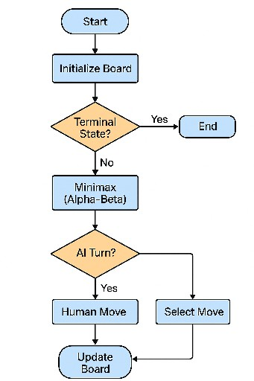

Slide 5







•
Windows or any modern OS, Python programming language, and an IDE like VS Code or PyCharm. Optional libraries such as Pygame or Tkinter can be used for the game interface.
•
A basic computer with at least an Intel i3 processor, 2 GB RAM, and standard input devices like keyboard and mouse. No special hardware is required.

Slide 6
const gameState = {
board: Array(9).fill(''),
currentPlayer: 'X',
gameOver: false,
scores: {
player: 0,
ai: 0,
ties: 0
},
difficulty: 'medium'
};
// Initialize board
function initializeBoard() {
const gameBoard = document.getElementById('game-board');
gameBoard.innerHTML = '';
for (let i = 0; i < 9; i++) {
const cell = document.createElement('div');
cell.className = 'cell';
cell.dataset.index = i;
cell.addEventListener('click', () => handleCellClick(i));
gameBoard.appendChild(cell);
}
}

Slide 7
// Handle player click
function handleCellClick(index) {
if (gameState.board[index] !== '' || gameState.gameOver || gameState.currentPlayer !== 'X') return;
makeMove(index, 'X');
if (!checkGameOver()) {
setTimeout(() => {
const aiMove = getAIMove();
makeMove(aiMove, 'O');
checkGameOver();
}, 500);
}
}
// Make move
function makeMove(index, player) {
gameState.board[index] = player;
const cell = document.querySelector(`.cell[data-index="${index}"]`);
cell.textContent = player;
cell.classList.add(player.toLowerCase());
}

Slide 8
// Check winner patterns
function checkWinner() {
const winPatterns = [
[0, 1, 2], [3, 4, 5], [6, 7, 8],
[0, 3, 6], [1, 4, 7], [2, 5, 8],
[0, 4, 8], [2, 4, 6]
];
for (const pattern of winPatterns) {
const [a, b, c] = pattern;
if (gameState.board[a] &&
gameState.board[a] === gameState.board[b] &&
gameState.board[a] === gameState.board[c]) {
return { player: gameState.board[a], line: pattern };
}
}
return null;
}
// Full board check
function isBoardFull() {
return gameState.board.every(cell => cell !== '');
} function highlightWinningCells(line) {
line.forEach(index => {
const cell = document.querySelector(`.cell[data-index="${index}"]`);
cell.classList.add('winning-cell');
});
}

Slide 9
// Game over check
function checkGameOver() {
const winner = checkWinner();
if (winner) {
gameState.gameOver = true;
highlightWinningCells(winner.line);
return true;
} else if (isBoardFull()) {
gameState.gameOver = true;
return true;
}
return false;
}
// AI move (minimax + alpha beta)
function getAIMove() {
// Easy: random
if (gameState.difficulty === 'easy' && Math.random() < 0.3) {
const moves = getAvailableMoves();
return moves[Math.floor(Math.random() * moves.length)];
}
// Medium: sometimes random
if (gameState.difficulty === 'medium' && Math.random() < 0.2) {
const moves = getAvailableMoves();
return moves[Math.floor(Math.random() * moves.length)];
}

Slide 10
// Hard: minimax
let bestScore = -Infinity;
let bestMove;
for (let i = 0; i < 9; i++) {
if (gameState.board[i] === '') {
gameState.board[i] = 'O';
let score = minimax(gameState.board, 0, false, -Infinity, Infinity);
gameState.board[i] = '';
if (score > bestScore) {
bestScore = score;
bestMove = i;
}
}
}
return bestMove;
}
// Minimax algorithm with pruning
function minimax(board, depth, isMaximizing, alpha, beta) {
const winner = checkWinnerForMinimax(board);
if (winner === 'O') return 10 - depth;
if (winner === 'X') return depth - 10;
if (isBoardFullForMinimax(board)) return 0;

Slide 11
if (isMaximizing) {
let bestScore = -Infinity;
for (let i = 0; i < 9; i++) {
if (board[i] === '') {
board[i] = 'O';
let score = minimax(board, depth + 1, false, alpha, beta);
board[i] = '';
bestScore = Math.max(score, bestScore);
alpha = Math.max(alpha, score);
if (beta <= alpha) break;
}
}
return bestScore;
} else {
let bestScore = Infinity;
for (let i = 0; i < 9; i++) {
if (board[i] === '') {
board[i] = 'X';
let score = minimax(board, depth + 1, true, alpha, beta);
board[i] = '';
bestScore = Math.min(score, bestScore);
beta = Math.min(beta, score);
if (beta <= alpha) break;
}
}

Slide 12
function getAvailableMoves() {
return gameState.board
.map((cell, index) => (cell === '' ? index : null))
.filter(cell => cell !== null);
}
function checkWinnerForMinimax(board) {
const winPatterns = [
[0, 1, 2], [3, 4, 5], [6, 7, 8],
[0, 3, 6], [1, 4, 7], [2, 5, 8],
[0, 4, 8], [2, 4, 6]
];
for (const pattern of winPatterns) {
const [a, b, c] = pattern;
if (board[a] && board[a] === board[b] && board[a] === board[c]) {
return board[a];
}
}
return null;
}
function isBoardFullForMinimax(board) {
return board.every(cell => cell !== '');
}
// Reset game
function resetGame() {
gameState.board = Array(9).fill('');
gameState.currentPlayer = 'X';
gameState.gameOver = false;
initializeBoard();
}

Slide 13
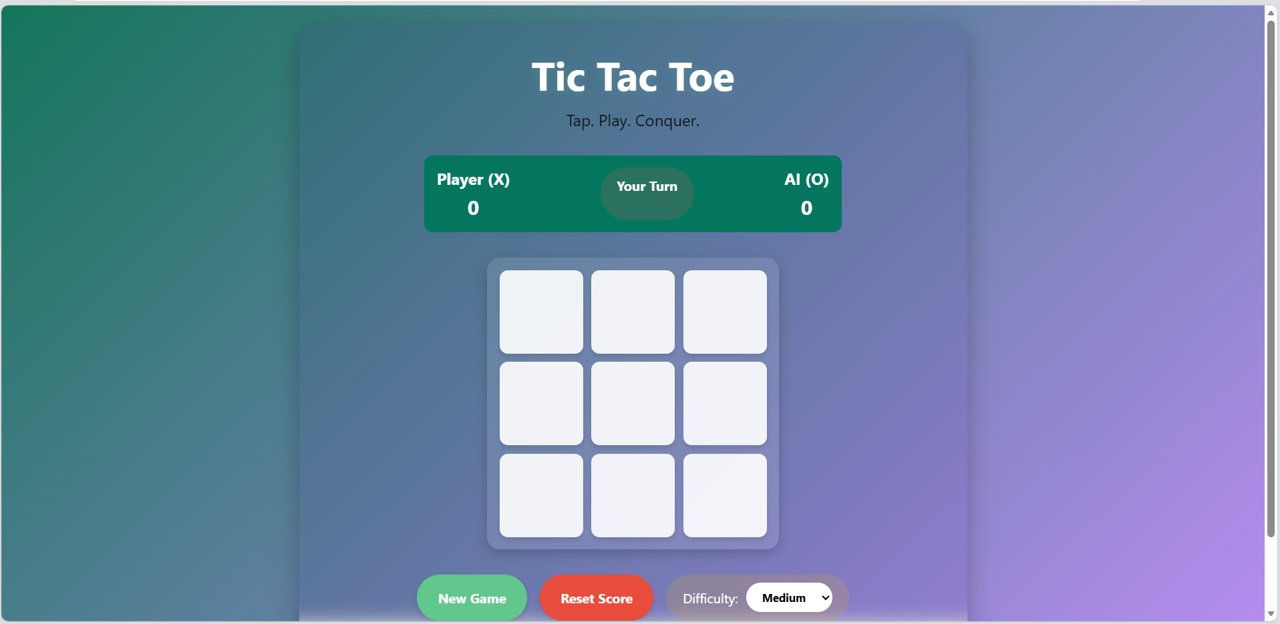
OUTPUT

Slide 14
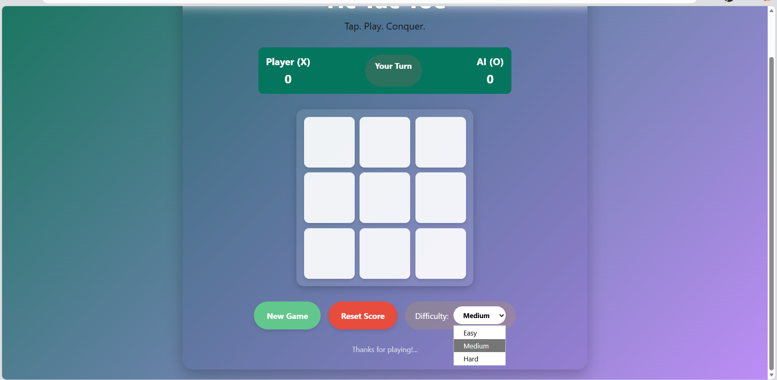

Slide 15
The Tic Tac Toe Game Tree project successfully demonstrates how artif icial intelligence can be applied to decision-making in games. Using the Minimax algorithm with Alpha-Beta Pruning, the AI ef ficiently selects optimal moves, providing an unbeatable opponent. The addition of dif ficulty levels through varying search depths enhances user interaction and makes the game more engaging.

